Slide 1

chapter 7
chapter 7
Practical issues of database application

Slide 2
Objectives
Understand transactions and their properties (ACID)
Apply transaction in database application programming
Understand the roles of indexing techniques
Implement indexes for query optimization
Understand what views are for and how to use them
Understand query execution plan for query optimization analysis

Slide 3
Contents
1. Transaction in SQL
2. Indexes in SQL & Query optimization
3. Views

Slide 4
Introduction
DB User operates on database by querying or modifying the database
Operations on database are executed one at a time
Output of one operation is input of the next operation
So, how the DBMS treats simultaneous operations?

Slide 5
Serializability (tuần tự)
In applications, many operations per second may be performed on database
These may operate on the same data
We’ll get unexpected results

Slide 6
Serializability
Example: Two users book the same seat of the flight
time | User 1 finds a seat empty
 |  | User2 finds a seat empty
 | User1 sets seat 22A occupied
 |  | User2 sets seat 22A occupied

Slide 7
Serializability
Transaction
- is a group of operations that need to be performed together.
- A certain transaction must be serializable with respect to other transactions, that is, the transactions run serially – one at a time, no overlap

Slide 8
Atomicity (tính nguyên tử)
A certain combinations of database operations need to be done atomically, that is, either they are all done or neither is done

Slide 9
Atomicity
Example:
Transfer $500 from the account number 3209 to account number 3208 by two steps
(1) Subtract $500 from account number 3209
(2) Add $500 to account number 3208
What happen if there is a failure after step (1) but before step (2)?

Slide 10
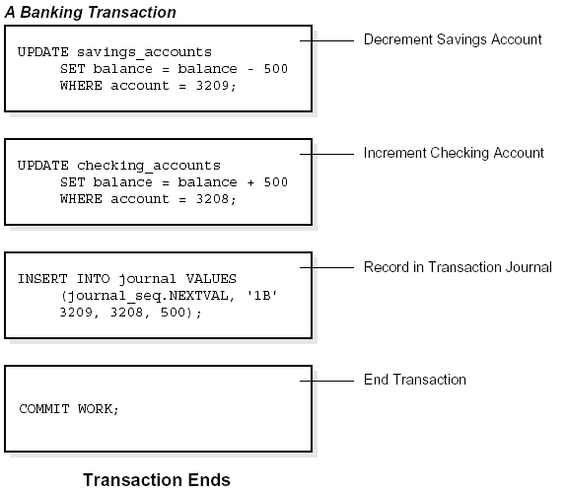
Atomicity
$500
ACC: 3209
$500
ACC: 3208

Slide 11
Transactions
Transaction is a collection of one or more operations on the database that must be executed atomically
That is, either all operations are performed or none are
In SQL, each statement is a transaction by itself
SQL allows to group several statements into a single transaction

Slide 12
Transactions
Transaction begins by SQL command START TRANSACTION
Two ways to end a transaction
The SQL statement COMMIT causes the transaction to end successfully
The SQL statement ROLLBACK causes the transaction to abort, or terminate unsuccessfully

Slide 13
ACID properties of Transaction
Atomicity (nguyên tử): Giao dịch phải hoàn thành toàn bộ hoặc không thực hiện gì cả. Nếu một phần của giao dịch thất bại, toàn bộ giao dịch sẽ bị hủy và không có thay đổi nào được thực hiện trong cơ sở dữ liệu.
Consistency (nhất quán): Giao dịch phải đưa cơ sở dữ liệu từ một trạng thái hợp lệ này sang một trạng thái hợp lệ khác
Isolation (độc lập): Giao dịch phải được thực hiện một cách độc lập với các giao dịch khác
Durability (bền vững): Sau khi một giao dịch đã hoàn thành, các thay đổi của nó sẽ tồn tại ngay cả khi có sự cố xảy ra, như mất điện hoặc hệ thống gặp lỗi.

Slide 14
ACID properties of Transaction
Atomicity: a transaction is an atomic unit of processing; it should either be performed in its entirety or not performed at all.
At the end of the transaction, either all statements of the transaction is successful or all statements of the transaction fail.
If a partial transaction is written to the disk then the Atomic property is violated
Consistency: a transaction should be consistency preserving, meaning that if it is completely executed from beginning to end without interference from other transactions, it should take the database from one consistent state to another.

Slide 15
ACID properties of Transaction
Isolation: a transaction should appear as though it is being executed in isolation from other transactions, even though many transactions are executing concurrently. That is the execution of a transaction should not be interfered with by any other transactions executing concurrently.
Durability : the changes applied to the database by a committed transaction must persist in the database. These changes must not be lost because of any failure..

Slide 16
Read-Only Transactions
A transaction can read or write some data into the database
When a transaction only reads data and does not write data, the transaction may execute in parallel with other transactions
Many read-only transactions access the same data to run in parallel, while they would not be allowed to run in parallel with a transaction that wrote the same data

Slide 17
Transactions
SQL statement set read-only to the next transaction
SET TRANSACTION READ ONLY;
SQL statement set read/write to the next transaction
SET TRANSACTION READ WRITE;

Slide 18
Basic Transaction Commands
BEGIN TRANSACTION: Marks the starting point of a transaction.
COMMIT: Saves all changes made by the transaction to the database.
ROLLBACK: Undoes all changes made by the transaction if an error occurs or if you want to cancel it.

Slide 19
Dirty Reads
Dirty data: data written by a transaction that has not yet committed
Example:
Let's say we are transferring money between two accounts. We want to ensure that either both the debit (ghi nợ) and credit(ghi có) actions are successfully completed, or none at all, to avoid data inconsistency (e.g., deducting money from one account without adding it to the other).

Slide 20
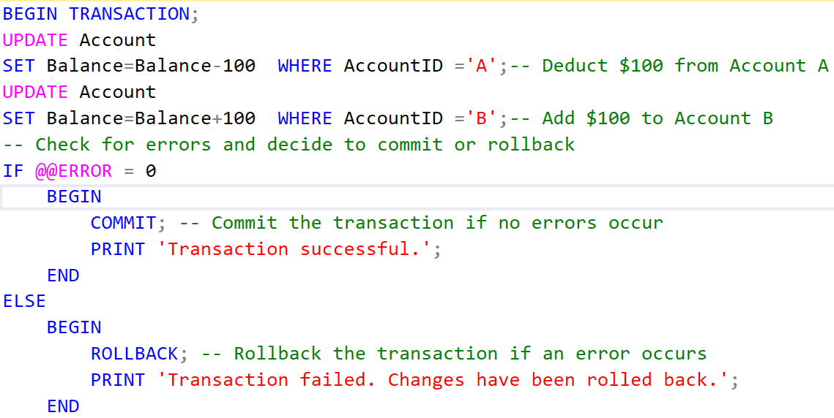
Transaction Example

Slide 21
Explanation:
BEGIN TRANSACTION: Starts a new transaction.
UPDATE statements: Execute the debit and credit operations.
@@ERROR: System function that returns 0 if the last operation was successful, or an error code if it failed.
COMMIT: Confirms and saves the transaction's changes to the database.
ROLLBACK: If any part of the transaction fails, it undoes all the changes made in the transaction, ensuring data integrity.

Slide 22
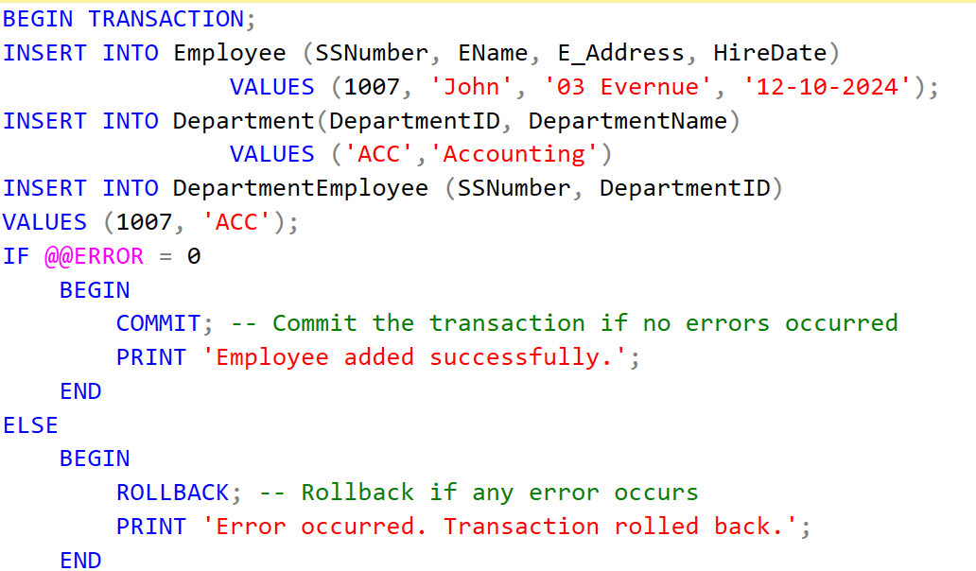
Example 1:

Slide 23
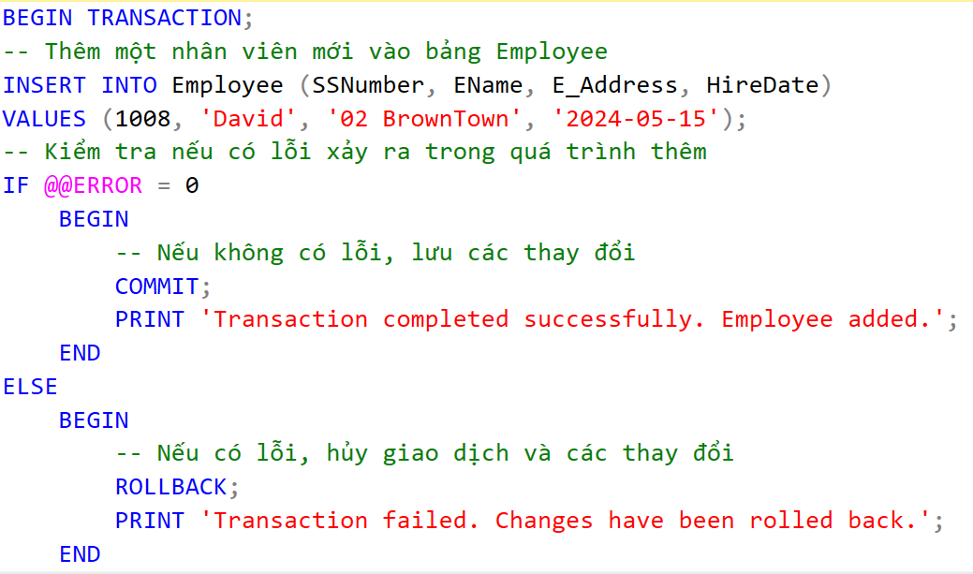
Example 2:

Slide 24
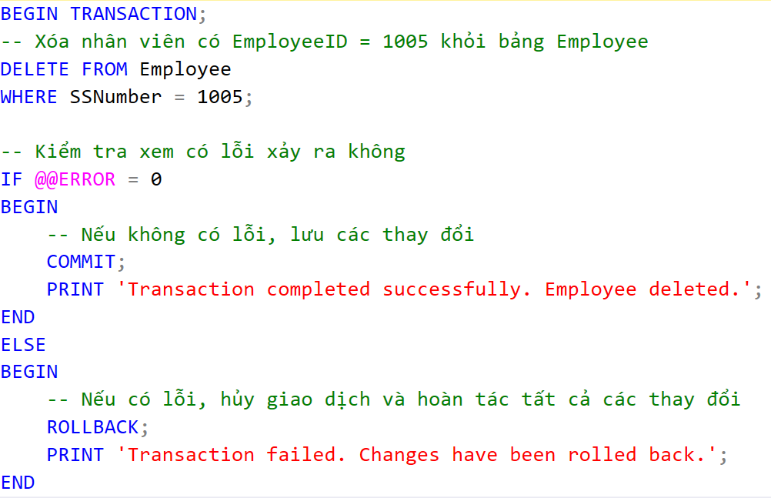
Example 3:

Slide 25
Index overview
In SQL Server, an index is a database object that improves the speed of data retrieval operations on a table by providing a more efficient path to locate rows.
It is similar to an index in a book, which allows you to quickly find specific information without having to read through the entire content.

Slide 26
Index overview
An index on attribute A is a data structure that makes it efficient to find those tuples that have a fixed value for attribute A.
Can dramatically speed up certain operations:
Find all R tuples where R.A = v
Find all R and S tuples where R.A = S.B
Find all R tuples where R.A > v (sometimes, depending on index type)
Example
SELECT * FROM Student WHERE name = 'Mary’
Without index: Scan all Student tuples
With index: Go "directly" to tuples with name='Mary'
Indexes are built on single attributes or combinations of attributes.

Slide 27
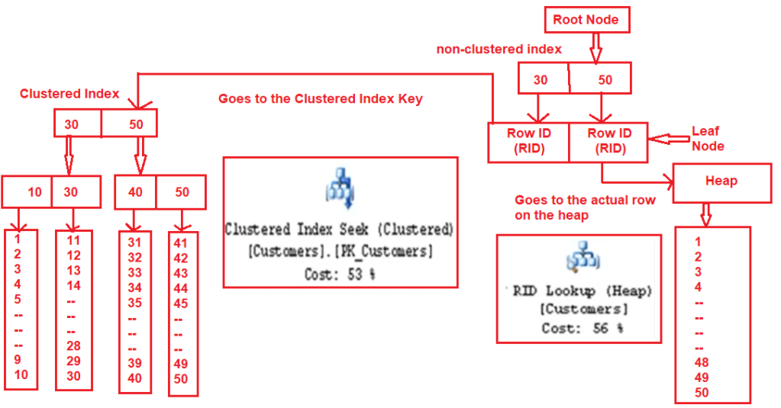
Type of indexes

Slide 28

Type of indexes
1) Clustered Index:
A clustered index sorts and stores the data rows of the table or view based on the index key.
There can only be one clustered index per table, because the data rows themselves are stored in order.
The clustered index determines the physical order of the data in the table.
For example, if a table has a clustered index on a column like EmployeeID, the rows will be physically sorted in the order of EmployeeID.

Slide 29

Type of indexes
2) Non-Clustered Index:
Contains a sorted copy of the indexed columns and pointers to the actual rows in the table.
The data is not physically ordered by this index, but the index provides a fast way to find rows.
A table can have multiple non-clustered indexes.

Slide 30
Indexes implementation on SQL
CREATE CLUSTERED INDEX index_name ON dbo.Tablename(ColumnName1,ColumnName2...)
CREATE NONCLUSTERED INDEX index_name ON dbo.Tablename(ColumnName1, ColumnName2...)
DROP INDEX index_name
//demo required

Slide 31
Index design guidelines
Choosing which indexes to create is a difficult and very important design issue. The decision depends on size of tables, data distributions, and most importantly query/update load.
Table Size: enough large. Why?
Column Types:
Small size (INT, BIGINT). Should create clustered index on Unique and NOT NULL field.
Identity field (automatically increment)
Static field
Number of indexes
Storage Location of Indexes
Index Types
Query design

Slide 32
3. Views
Relations
Actual exist in database in some physical organization
Defined with a CREATE TABLE statement
Exist indefinitely and not to change unless explicit request
Views
Do not exist physically
Defined by an expression like a query
Can be queried and can even be modified

Slide 33
Views
A view just a relation, but we store a definition rather than a set of tuples
Syntax:
USER
VIEW
DATA TABLES
CREATE VIEW view_name AS
SELECT column1, column2, ...
FROM table_name
WHERE condition;

Slide 34
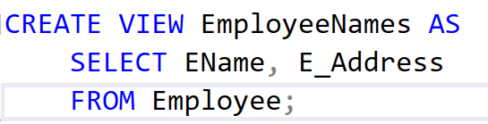
Views
Types of views in SQL Server:
Simple view or Updatable views: single table, can INSERT, UPDATE, DELETE through view.
Complex view or non-updatable views: multi tables

Slide 35
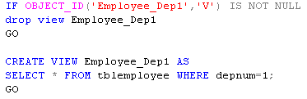
Example 1
Example 2

Slide 36
Querying Views
Find all dependents of the employees who work in department 1
SELECT *
FROM Employee_Dep1 ed1, tblDependent d
WHERE ed1.empSSN=d.empSSN
SELECT *
FROM (SELECT *
FROM tblEmployee
WHERE depNum=1
) ed1, tblDependent d
WHERE ed1.empSSN=d.empSSN

Slide 37
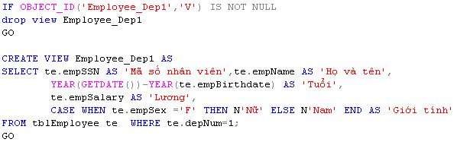
Renaming Attributes
Example 3:
Create view for all employees of Department number 1, including: SSN, Fullname, Age, Salary, Sex

Slide 38
Modifying Views
With updatable views, the modification is translated into an equivalent modification on a base table
The modification can be done to the base table

Slide 39
View Removal
As we know, Employee_Dep1 is associated to tplEmployee relation
DROP VIEW Employee_Dep1;
Delete the definition of the view
Does not effect on tplEmployee relation
DROP TABLE tplEmployee;
Delete tplEmployee relation
Make the view Employee_Dep1 unusable

Slide 40
Updatable Views
We can modify views that are defined by selecting some attributes from one relation R, and
Sub query started by SELECT, not SELECT DISTINCT
The WHERE clause must not involve R in a sub query
The FROM clause can only consist of one occurrence of R and no other relation
The list in the SELECT clause must include enough attributes that for every tuple inserted into the view, we can fill the other attributes out with NULL values or the proper default

Slide 41
Updatable Views
Example 4:
Create view from table Employee
Do changes on Employee and review created view
Do changes on created view and review Employee

Slide 42
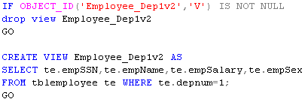
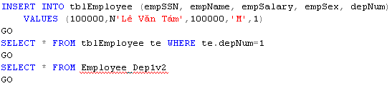
Update on table effects on view

Slide 43
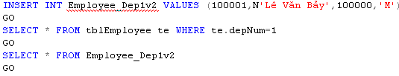
Update on view effects on table with unexpected result

Slide 44
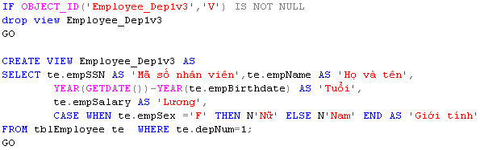
Update on view raises error on table

Slide 45
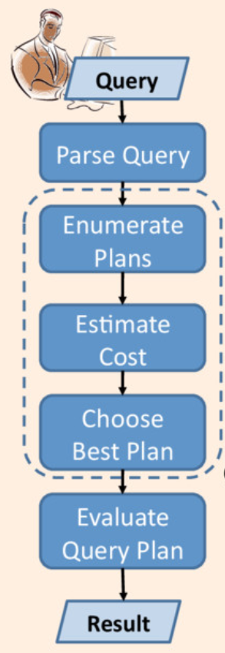
Query optimization
In practice:
Define the requirements: Who? What? Where? When? Why?
SELECT fields instead of using SELECT *
Avoid SELECT DISTINCT
Indexing
Create joins with INNER JOIN (not WHERE)
To check the existence of records, use EXISTS() rather than COUNT()
Ignore linked subqueries
Use of temp table
Don’t run queries in a loop
Limit your working data set size
optimize

